Slide 1
Case Study
ITVADANT EDUCATION

Slide 2
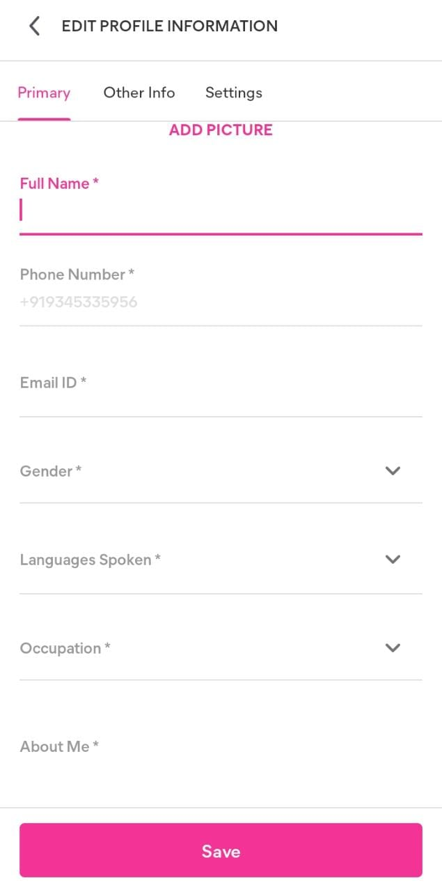
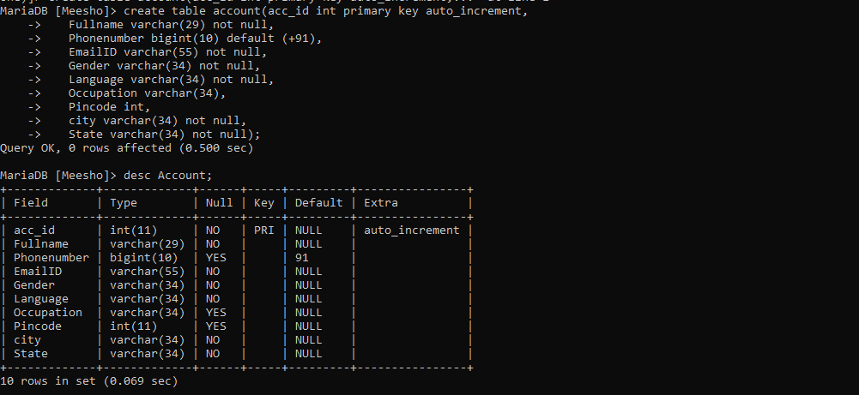
Create table, Insert values for Sign up new Account
create table account(acc_id int primary key auto_increment, Fullname varchar(29) not null, Phonenumber bigint(10) default (+91), EmailID varchar(55) not null,Gender varchar(34) not null,Language varchar(34) not null, Occupation varchar(34),Pincode int,city varchar(34) not null,State varchar(34) not null);

Slide 3
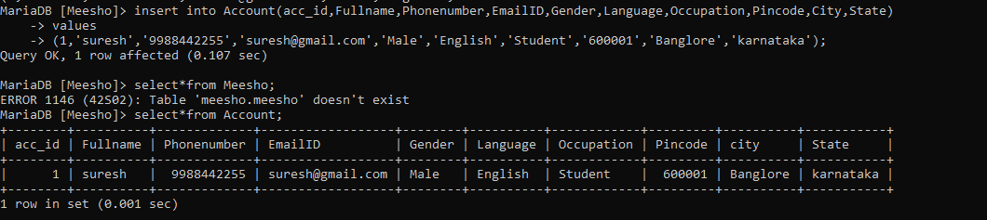
Create table account_info Create Simple View address,Constraints,
insert into Account(acc_id,Fullname,Phonenumber,EmailID,Gender,Language,Occupation,Pincode,City,State)
Values (1,'suresh','9988442255','suresh@gmail.com','Male','English','Student','600001','Banglore','karnataka');

Slide 4
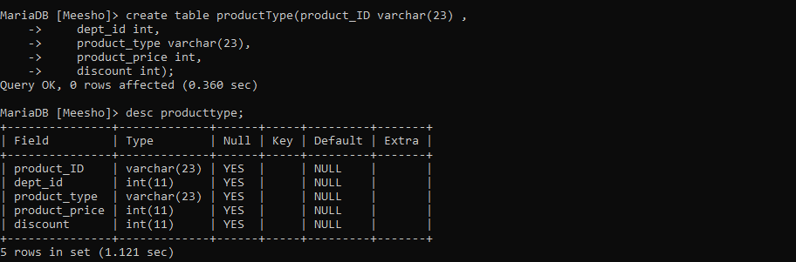
create table productType(product_ID varchar(23) ,dept_id int,
product_type varchar(23),product_price int,discount int);

Slide 5
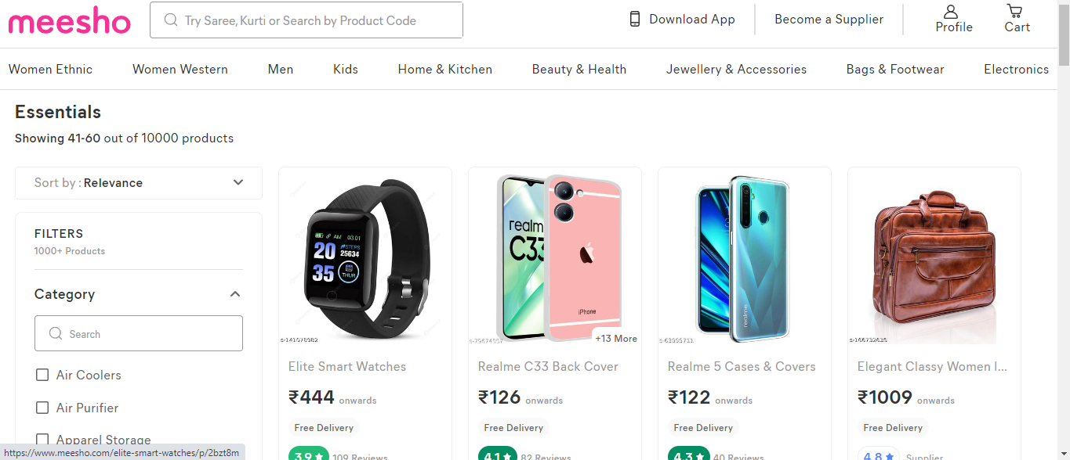

Slide 6
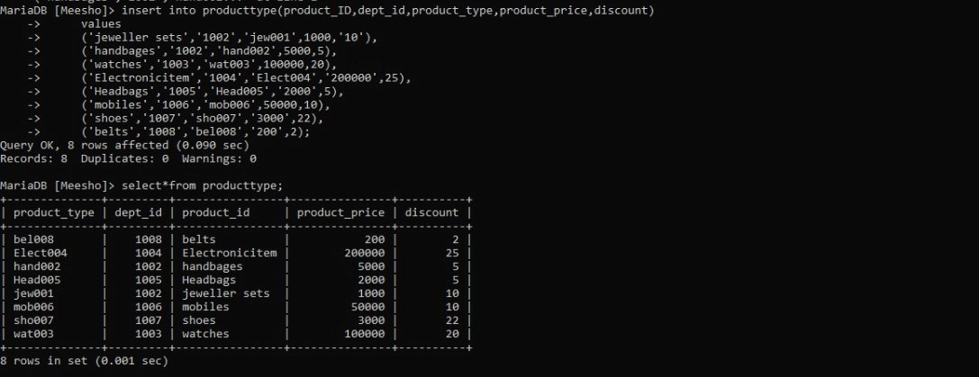
insert into producttype(product_type,dept_id,product_id,product_price,discount)
-> values
-> ('jew001','1002','jeweller sets',1000,'10%'),('hand002','1002','handbags',5000,5),
-> ('wat003','1003','watchs',2000,20), ('Elec004','1004','Electronicitem','200000',25), ('Head005','1005','Headphones','2000',5),
-> ('mob006','1006','mobilephone',50000,10),('sho007','1007','shoes','3000',22), ('bel008','1008','belts','200',2);

Slide 7
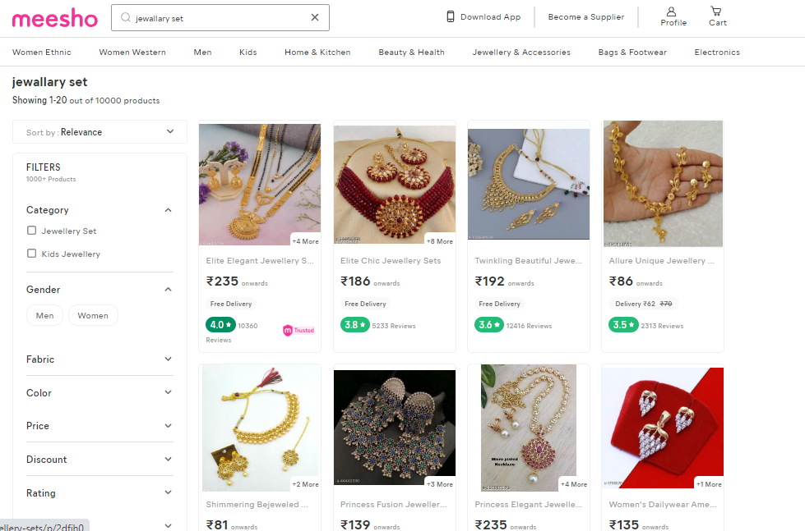
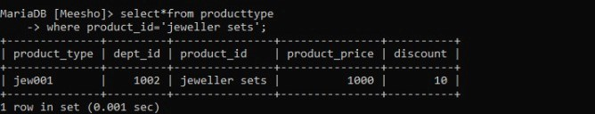

Slide 8
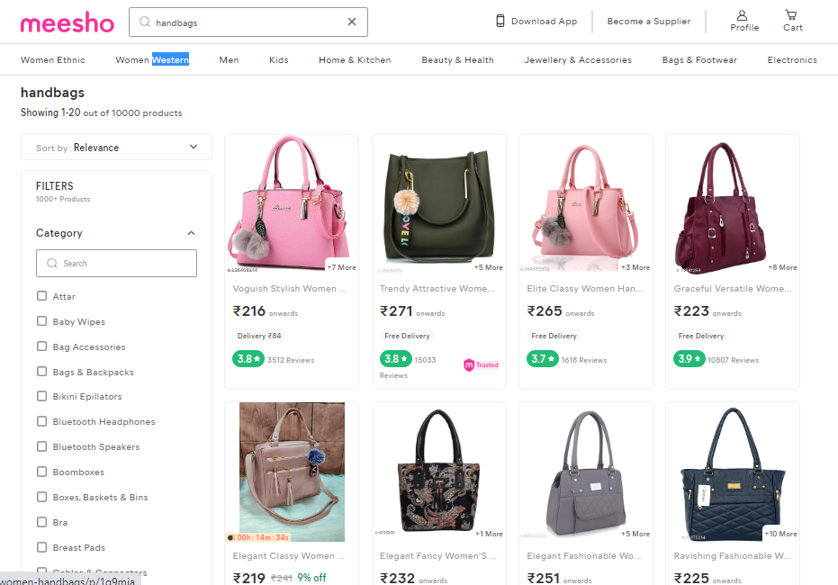
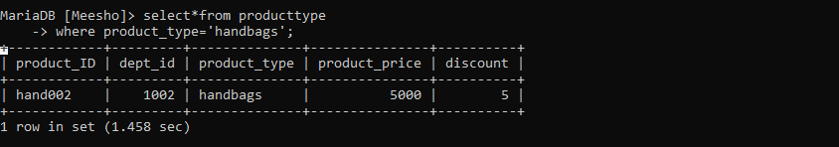

Slide 9
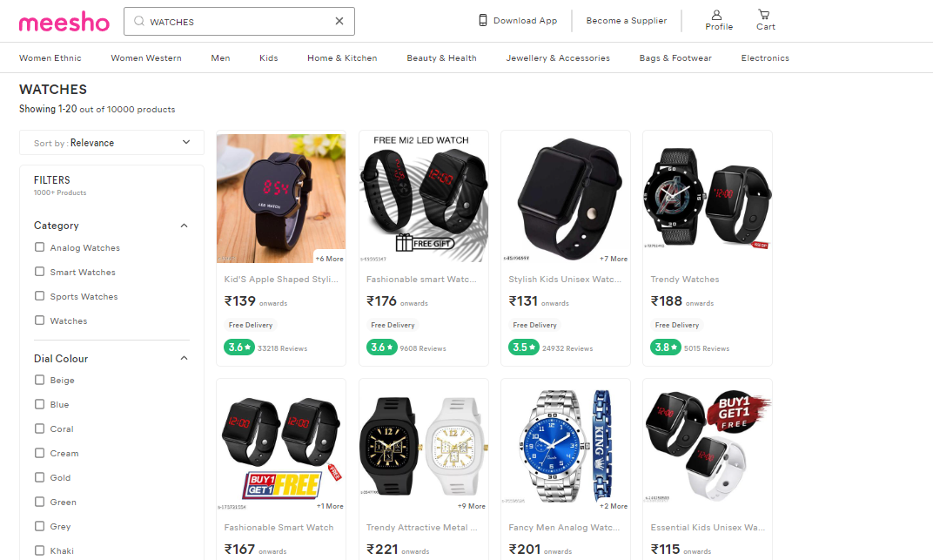
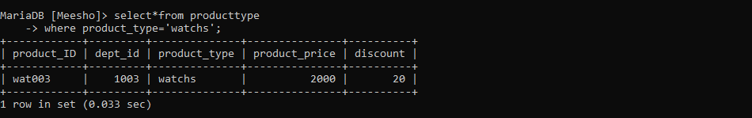

Slide 10
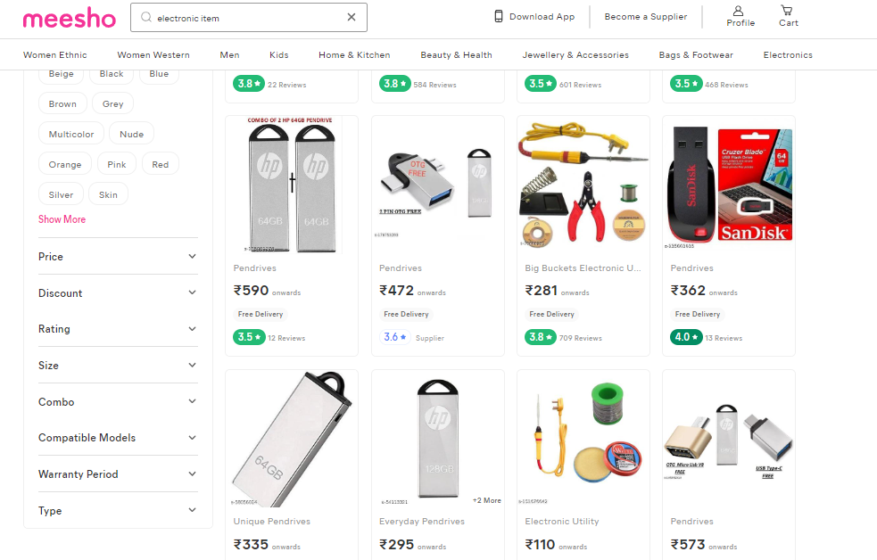
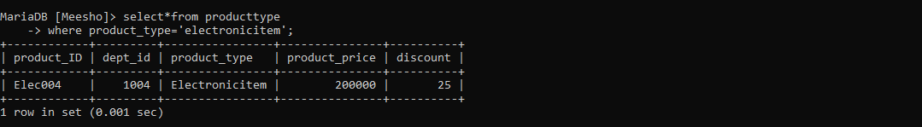

Slide 11
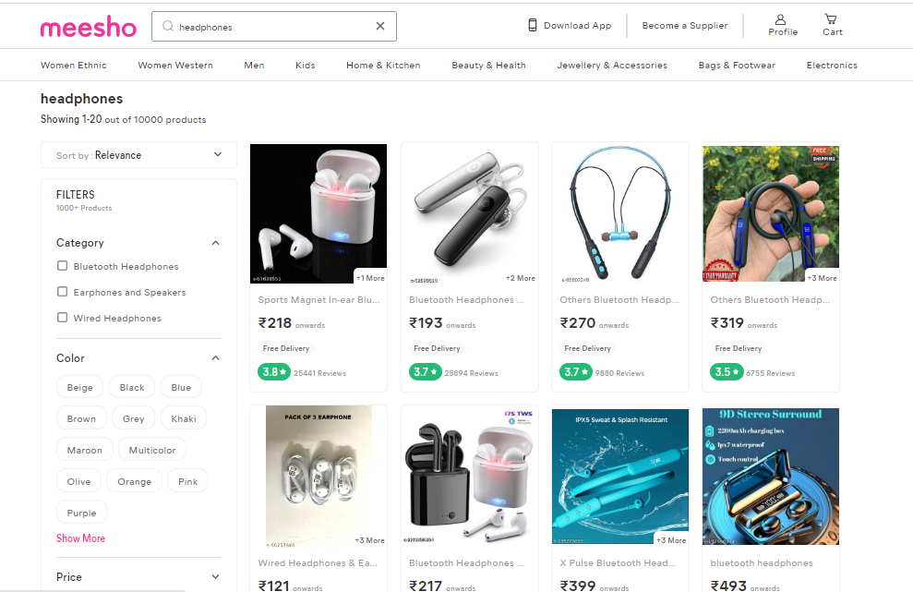
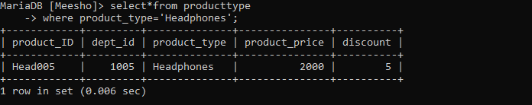

Slide 12
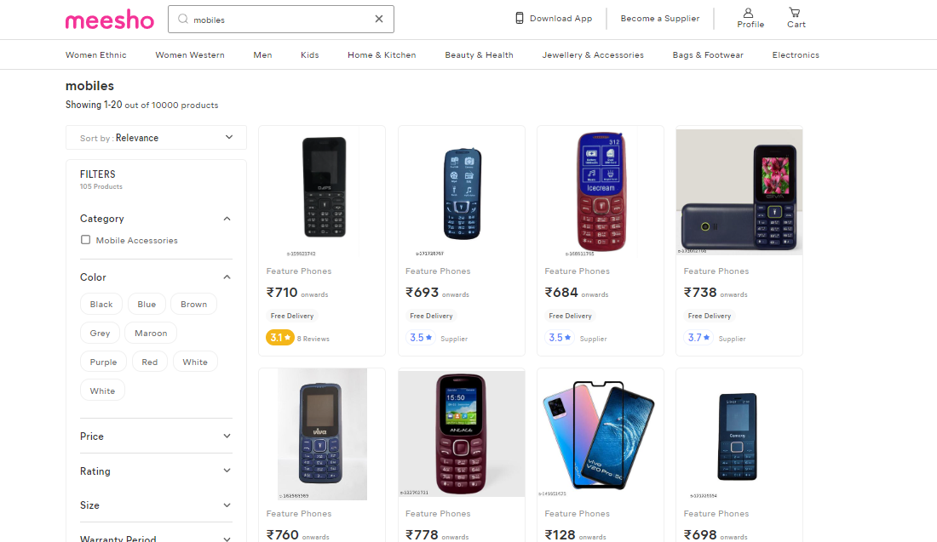
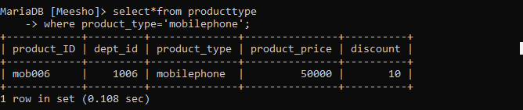

Slide 13
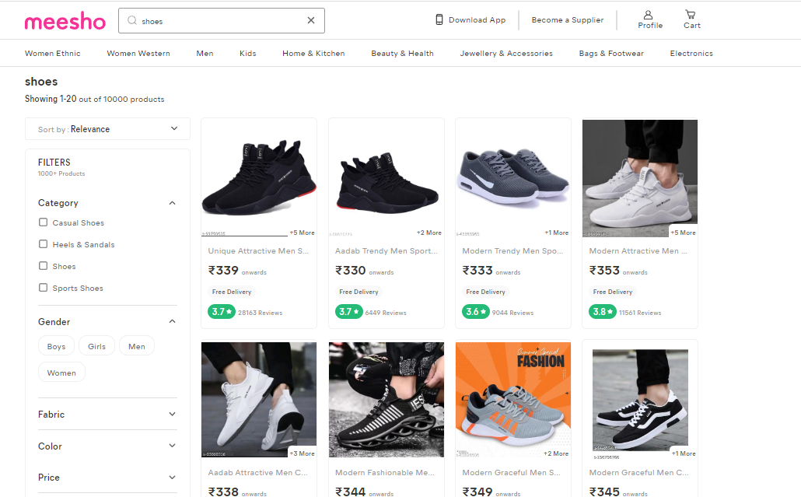
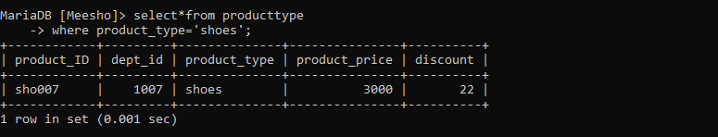

Slide 14
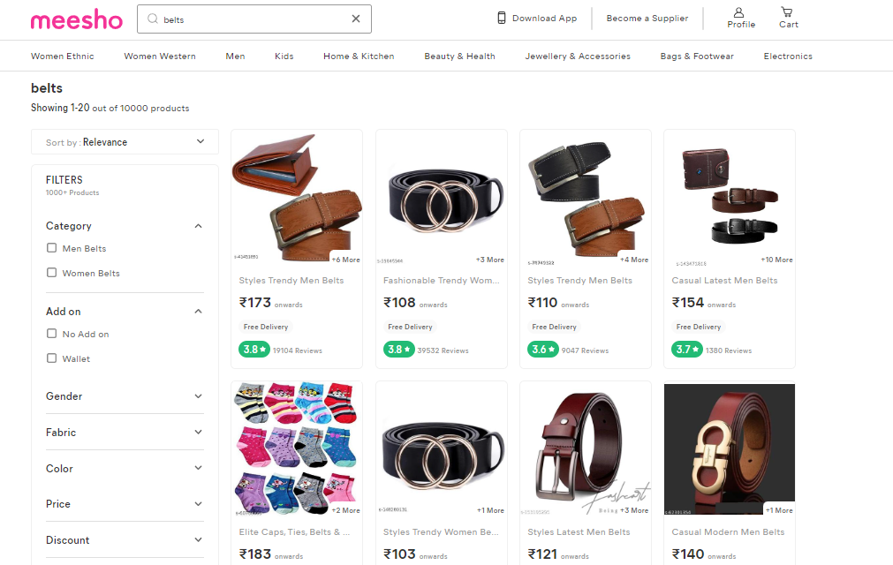
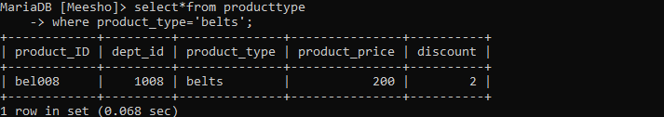

Slide 15
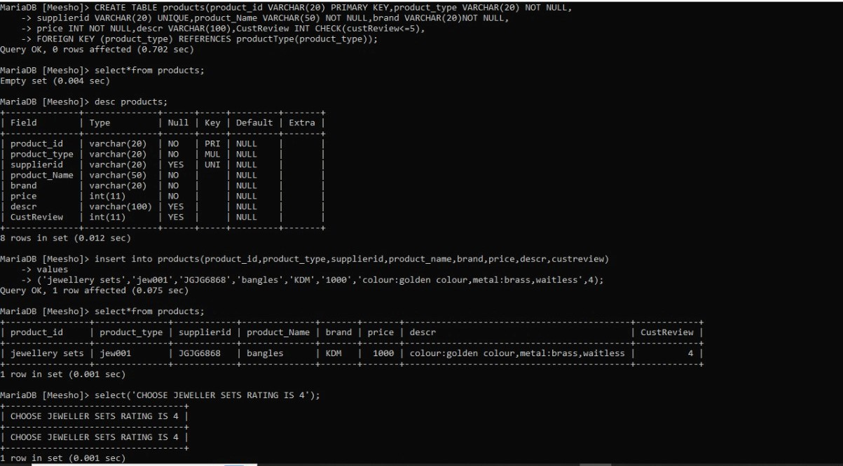
SubQury to choose jewellery sets

Slide 17
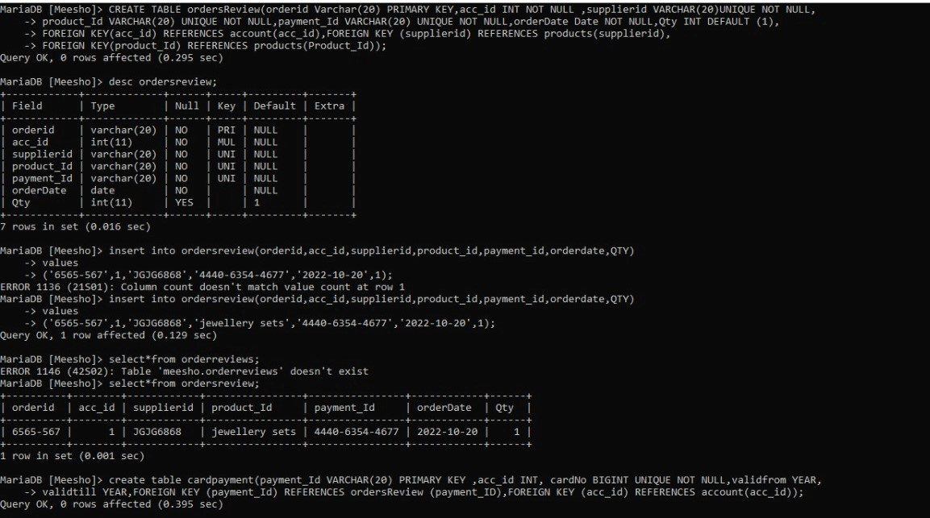
create table view join three tables

Slide 18
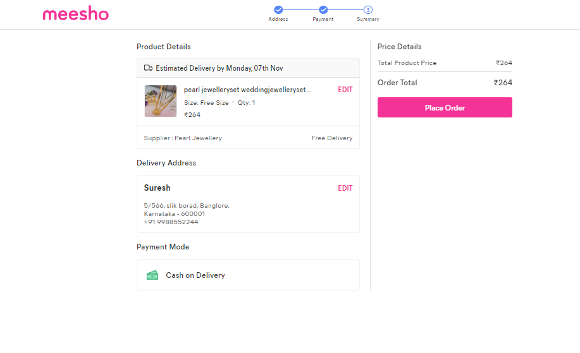

Slide 19
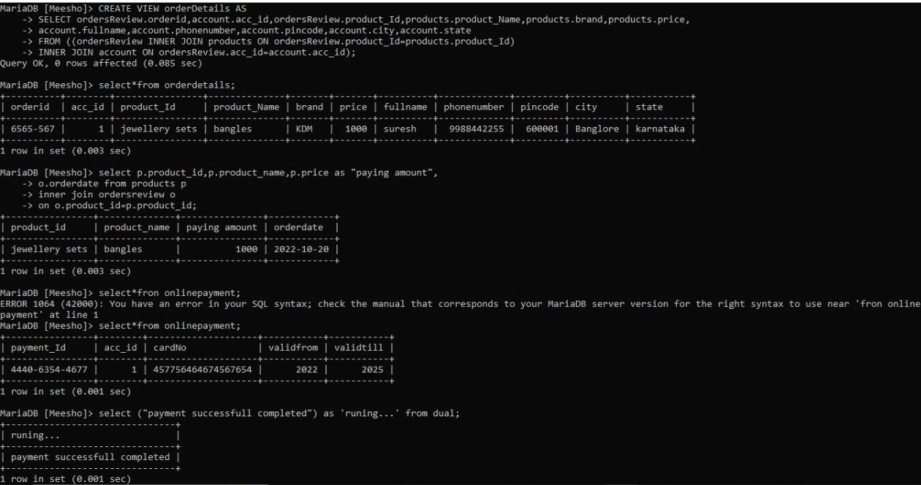
joins for process payments

Slide 20
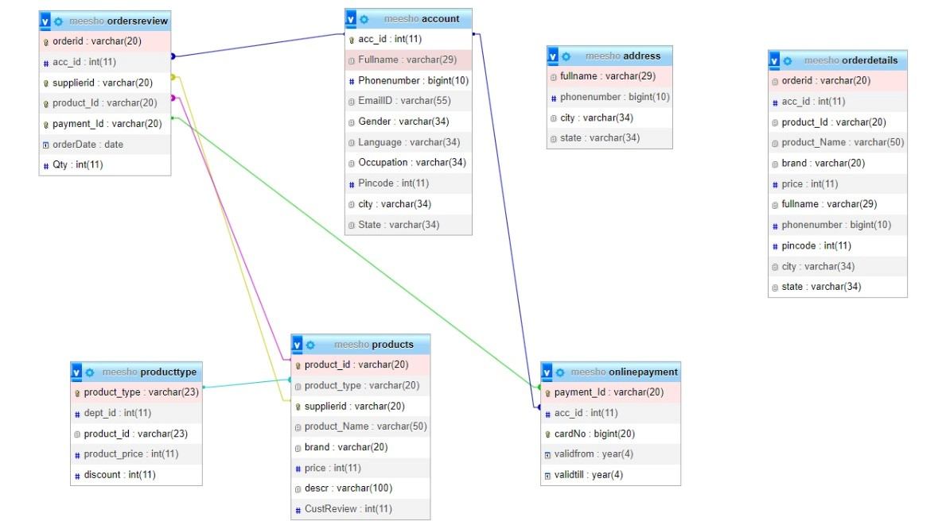
ER Diagram

Slide 21


